Slide 1
Financing of Projects
Unit - 5

Slide 2
Contents
Capital structure
Menu of financing
Equity capital
Internal accruals
Term loans
Debentures
Working capital advance
Miscellaneous sources
Raising of venture capital
Raising capital in international markets

Slide 3
Financing of Projects
Project financing is intertwined with project planning, analysis and selection
A capital project entails investment in land, plant and machinery, miscellaneous fixed assets, technical know-how, distribution network and working capital

Slide 4
Financing decisions are relatively easier than investment decisions
Financing Decisions | Investment Decisions
Take place in capital markets which are approximately perfect | Take place in real markets which tend to be imperfect
The value of similar financial assets can be observed & studied | The value of the capital projects have to be estimated
There are few opportunities in the realm of financing that have an NPV that is significantly different from zero | There are many opportunities in the realm of capital budgeting that have an NPV that is significantly different from zero

Slide 5
Capital Structure
Shareholder’s funds (Equity capital, retained earnings, preference capital)
Loan funds (debenture capital, term loans, deferred credit, fixed deposit, and working capital advance)
Equity | Debt
Equity shareholders have a residual claim on the income and the wealth of the firm | Creditors have a fixed claim in the form of interest and principal amount
Dividend paid to equity shareholders in not a tax deductible payment | Interest paid to creditors is a tax deductible payment
Has an indefinite life | Has a fixed maturity
Equity investors enjoy the prerogative to control the affairs of the firm | Debt investors play a passive role

Slide 6
Key factors in determining the Debt-Equity Ratio
Cost
Nature of assets
Business risk
Norms of lenders
Control considerations
Market conditions

Slide 7
Equity versus Debt
Use more equity when | Use more debt when
The tax rate applicable is negligible | The tax rate applicable is high
Business risk exposure is high | Business risk exposure is low
Dilution of control is not an important issue | Dilution of control is an issue
The assets of the project are mostly intangible | The assets of the project are mostly tangible
The project has many valuable growth options | The project has few growth options

Slide 8
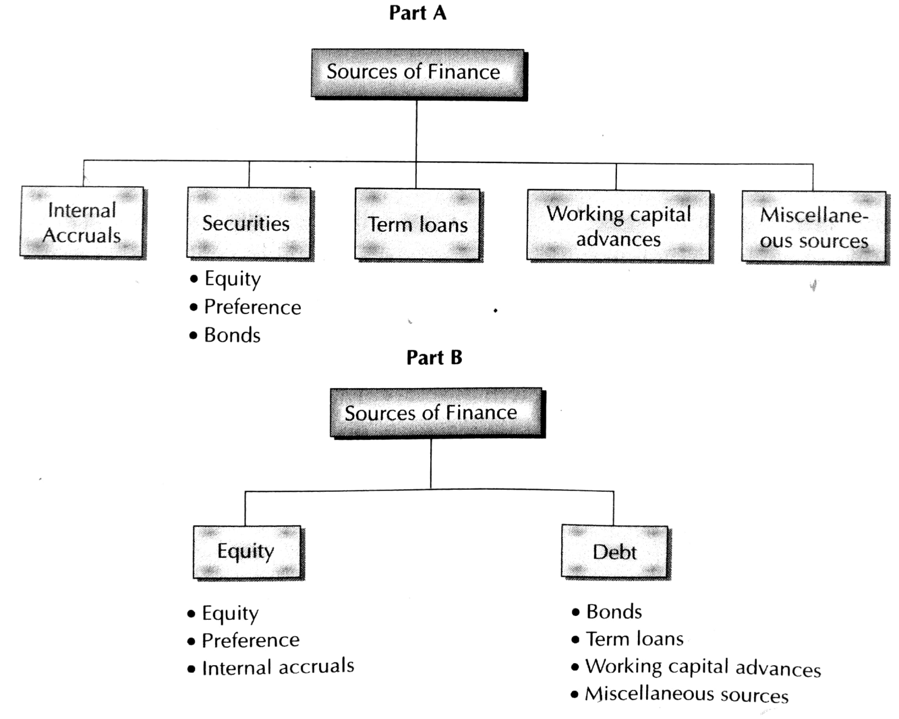
Menu of Financing
Sources of Finance

Slide 9
Public and Private Sources of Capital
The Typical Pattern of Financing
Internal Accruals
Consist of deprecation charges and retained earnings
Depreciation represents the allocation of capital expenditure to various periods over which the capital expenditure is expected to benefit the firm
Retained earnings are that portion of equity earnings which are ploughed back in the firm
Internal accruals are readily available
Eliminates issue costs and losses on account of underpricing
No dilution of control
Stock market generally views an equity issue with skepticism, however, internal accruals do not carry such negative connotation

Slide 10
Disadvantages of internal accruals
Amount available may be limited
The opportunity cost of retained earnings is quite high as – retained earnings, in essence represent dividends foregone by equity shareholders
The opportunity cost of depreciation-generated funds is equal to the weighted average cost of the firm
Comforted by the easy availability of internal accruals and the notion that they have a low cost, managements may invest in sub-marginal projects that destroy shareholder value

Slide 11
Equity Capital
Terms involved
Authorized, Issued, Subscribed, and Paid-up Capital
Par value, Issue price, book value, and market value
Rights of equity shareholders
Right to income
Right to control
Pre-emptive right
Right in liquidation

Slide 12
Advantages of Equity Capital
No compulsion to pay dividends
Has not maturity date, hence no obligation to redeem
Enhances the creditworthiness of the company
Equity dividends are tax-exempt in the hands of investors
Disadvantages of Equity Capital
Dilutes the control of existing owners
Cost of equity capital is high
Equity dividends are paid out of profit after tax, whereas interest payments are tax-deductible expenses
The cost of issuing equity shares is generally higher than the cost of issuing other types of securities

Slide 13
Preference Capital
A hybrid form financing – equity and debentures
It resembles equity in the following ways:
Preference dividend is payable only out of distributable profits
It is not obligatory payment
Not a tax-deductible payment
It resembles debentures in the following ways:
Dividend rate is usually fixed
The share of preference share holders is prior to the claim of equity share holders
Preference share holders do not normally enjoy the right to vote

Slide 14
Types of preference shares
Cumulative and non-cumulative preference shares
Participating and non-participating preference shares
Redeemable and non-redeemable preference shares
Convertible and non-convertible preference shares
Advantages of preference capital
No legal obligation to pay preference dividend
No redemption liability
Regarded as part of net worth
Do not carry voting right, hence no dilution of control
No security of assets is provided to preference share holders

Slide 15
Shortcomings of preference capital
More expensive than debt capital
Skipping payment of preference dividends adversely affect the image of the firm in the capital market
Shareholders have a prior claim on the assets and earnings of the firm
If a firms skips preference dividends for three years, it has to grant voting rights

Slide 16
Debentures (or bonds)
Debenture holders are the creditors of the company
Features
Appointment of trustee
Typically secured by mortgages / charges on the immovable properties
Corporate debt may be short, medium or long term
Typically redeemable in nature
May carry fixed or floating rate of interest or zero rate of interest
Call feature: provides the issuing company the option to redeem at a certain price before the maturity period
Put feature: gives the holder the right to seek redemption at specified times at predetermined prices

Slide 17
Innovations in debentures
Deep Discount Bonds
Convertible debentures
Floating rate bonds
Secured premium notes
Indexed bonds

Slide 18
Advantages of Debt Financing
Interest on debt is a tax-deductible expense
No dilution of control
Payments are limited to interest and principal
Issue costs of debt are significantly lower
Protection against high unanticipated inflation
Maturity of a debt instrument can be tailored to the needs of the borrowing firm
Disadvantages of Debt Financing
Failure to meet the obligations can cause a great deal of financial embarrassment and even lead to bankruptcy
Increases financial leverage
Impose restrictions that limit the borrowing firm’s financial and operating flexibility
If the rate of inflation turns out to be unexpectedly low, the real cost of debt will be greater than expected

Slide 19
Methods of offering
Public offering
Initial public offering
Seasoned equity offering (secondary offerings)
Bond offering
Rights issue
Private placement
Private placement of bonds
Preferential allotment

Slide 20
Term Loans
Term loans or term finance, represent a source of debt finance which is generally repayable in less that 10 years
Features of term loans
Currency
Security
Interest payment and principal repayment
Restrictive covenants

Slide 21
Term Loan Procedure
Submission of loan application
Initial processing of loan application
Appraisal of the proposed project
Issue of the letter of sanction
Acceptance of terms and conditions by the borrowing unit
Execution of loan agreement
Creation of security
Disbursement of loans
Monitoring
Syndicated Loans

Slide 22
Working Capital Advances
Forms of bank finance
Cash credits / overdrafts
Loans
Purchase / Discount bills
Letter of credit
Application and processing
Sanction and terms and conditions
Security – Hypothecation, Pledge
Margin amount

Slide 23
Miscellaneous sources
Deferred credit
Lease and hire purchase finance
Unsecured loans and deposits
Special schemes of institutions
Subsidies and sales tax deferments and exemption
Short-terms loans from financial institutions
Commercial paper
Factoring
Securitization

Slide 24
Deferred credit
Suppliers provide deferred credit facility under which payment for the purchase of machinery is made over a period of time
Interest rate and period of payment vary
Usually supplier insists for bank guarantee
Lease finance and Hire purchase- supplementary form of debt finance
Lease finance: A lease represents a contractual arrangement whereby the lessor grants the lessee the right to use an asset in return for periodic lease rental payment
Two broad types – Finance lease and Operating lease

Slide 25
Hire-Purchase
The hiree purchases the asset and gives it on hire to the hirer
The hirer pays regular hire-purchase instalments over a specified period of time
The hiree charges interests on a flat basis
Total interest collected by the hiree is allocated over several years
Leasing | Hire-Purchase
The lessee cannot claim depreciation | The hirer is entitled to claim depreciation
The entire lease rental is a tax-deductible expense for the lessee | Only the interest component of the hire-purchase instalment is a tax-deductible expense for the hirer
The lessee, not being the owner of the asset, does not enjoy the salvage value of the asset | The hirer, being the owner of the asset, enjoys the salvage value of the asset

Slide 26
Unsecured loans and deposits
Special schemes of institutions
Bill Rediscounting scheme
Suppliers’ line of credit
Subsidies and Sales tax deferments and exemptions
Short-term loans from financial institutions
Commercial paper
Factoring
Securitization

Slide 27
Raising venture capital
Raising capital in international markets
Euromarkets
Eurocurrency loans
Eurocurrency bonds
Foreign domestic markets
US capital market
Other markets
Export credit schemes
Buyer’s credit
Supplier’s credit

Slide 28
Venture Capital
Introduction
VC investment Appraisal Process and Management
The Indian VC industry and regulations
How to approach a VC fund

Slide 29
Introduction
A new private company that is not yet ready or willing to tap the public financial markets may seek venture capital (VC)
VC is provided by VC funds, which are prepared to finance risky projects that appear to have promising prospects
VC Investors
Include financial institutions, corporations, individuals
VC funds: Pools of capital constituted for investing in relatively high-risk opportunities in anticipation of potentially high risk adjusted rates of return

Slide 30
Features of VC investment which distinguish it from other finance sources
High uncertainty levels
Technology risk
Product market risk
Management risk
Liquidity risk
Information disclosure

Slide 31
The VC investment appraisal process and management
Assessment of business and management
The emphasis of evaluation is on the following aspects
Management team
Business strategy
Exit focus
Valuation of a VC transaction
Identify the amount of capital to be invested by the investor
Identify the target rate of return
Estimate the multiple of the original investment that will fetch the required rate of return over the anticipated holding period
Project the market value of the firm
Estimate the percentage of the projected value that the investor needs to claim

Slide 32
The valuation of deals is influenced by the following factors
Outlook for the economy
Capital market conditions
Industry related factors
Deal related factors
Demand for and supply of capital
Deal Structuring
Investor – investee relationship
Post financing relationship
Exit from investments

Slide 33
Comparison between VC and PE
Feature | VC | PE
Investment Target | Early state businesses, expansion Innovative products, services, technologies Heavily dependent on external financing Unlisted companies | Later stage businesses, involves operational or financial restructuring, with or without management team and/or ownership changes Mature products, services Generally have large cash flows May be listed or unlisted
Horizon | Medium to long term: 3-8 years | Medium: 2-5 years
Risks | May be one or more of technology, product development, market response to product / service, management, operational and liquidity of investment | Limited to product-market risks and does not involve the other elements listed in the case of VC
Structure | Equity or equity-type instruments such as convertible debt or preference shares Syndication of investment, if any, among fellow VCs | Equity and debt combinations Syndicate may include financial institutions

Slide 34
Comparison between VC and PE, contd……
Feature | VC | PE
Post Financing engagement | Active as it encompasses board composition, top management team recruitment, strategy formulation and internal systems processes and controls | Less active Involvement limited to ensuring high quality governance
Investment management team | Former managers and entrepreneurs with tremendous experience and vast, powerful networks in professional and industrial circles, primarily keeping in mind the post financing engagement needs | Primarily, former financial market professionals

Slide 35
The Indian VC industry
Regulation of VC industry in India

Slide 36
References
Projects: Planning, Analysis, Financing, Implementation, and Review - Prasanna Chandra, 5th edition, Tata McGraw-Hill publishing company limited, 2005
Project Management: Choudhry S., Tata McGraw-Hill, 2010
Project management a system approach to planning scheduling and controlling- Harold Kerzner, CBS Publisher and distributors, 2002.
A management guide to PERT and CPM- WEIST and LeVY Eastern Economy of PH 2002.
T R Banga, N K Agarwal and S C Sharma -Industrial engineering and Management Sciences, -Khanna Publishers

